Slide 1
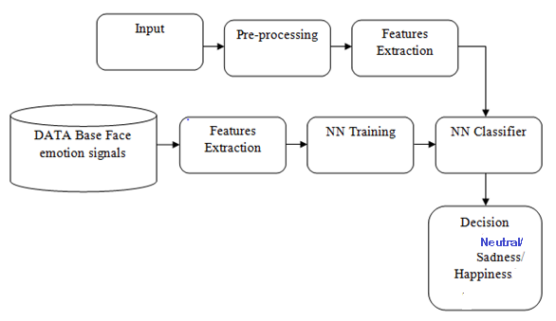
Meenakshi Sundararajan Engineering College : Department of Computer Science and Engineering
FACIAL EMOTION RECOGNITION SYSTEM
M.Hanishkar (311517205006)
M.Sugantha Priyan (311517205022)
S.Prasanna (311517205030)
INTERNAL GUIDE:
Mrs. M.R.Nithya,M.E
Assistant Professor, IT
EXTERNAL GUIDE:
BALAJI DHANANJAYAN
COMPANY NAME:
CROTUS TECHNOLOGIES
FEATURES:
This system detects the human emotions(happy,sad,neutral) from facial expressions in real time .
Libraries:Tensorflow,Numpy.
Framework and Architecture:Convolutional Neural Network.
ARCHITECTURE:

